Slide 1
Features of a Winner
NBA Predictive Analysis
April 10, 2018

Slide 2



Meet the Team
Conner Leavitt
Chase Johnson
Erik Webb

Slide 3
Objective
Predict the outcome of NBA regular-season games using classification machine learning algorithms.

Slide 4




Motivation
Data Availability
Data Objectivity
Feature Engineering
Interest

Slide 5

Literature Review
Glass ceiling of about 74% predictive accuracy.
Nate Silver & FiveThirtyEight CARM-ELO rankings.

Slide 6
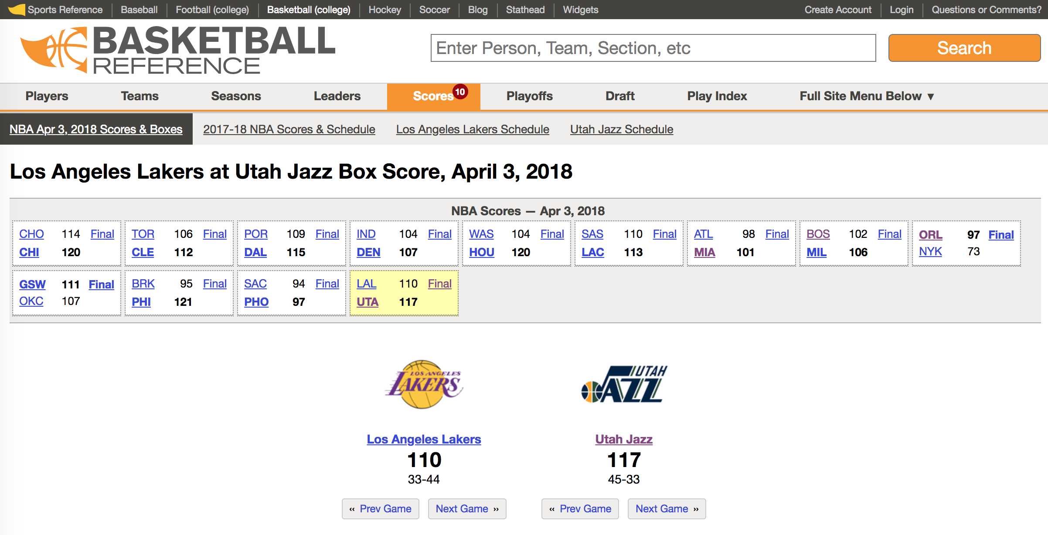
Data Source

Slide 7
Feature Engineering

